Slide 1



NAAN MUDHALVAN PROJECT
Presented By:
NAME :N.KIRUTHIGA DEVI
COLLEGE :ROHINI COLLEGE OF ENGINEERING AND TECHNOLOGY
STREAM :COMPUTER SCIENCE AND ENGINEERING
DEGREE :BE
NM ID :au963321104030
EMAIL ID :kiruthigadevilp@gmail.com

Slide 2
PROJECT TITLE
Stock Market Value Prediction System Using LSTN IN Recurrent Neural Network

Slide 3




AGENDA
Problem Statement
Project overview
Who are the end user
Solution and its Value Proposition
The WOW in Solution
Modelling
Result
Conclusion
3/21/2024 Annual Review

Slide 4


PROBLEM STATEMENT
Develop an accurate Stock Market Value Prediction System utilizing Recurrent Neural Networks (RNN). Collect and preprocess historical stock data, design an RNN architecture (e.g., LSTM/GRU), and fine-tune hyper parameters. Incorporate relevant financial indicators, ensure model interpretability, and deploy it for real-time predictions. Aim to empower investors and analysts with reliable insights into future stock price movements, enabling informed decision-making and enhancing investment strategies.

Slide 5

PROJECT OVERVIEW
This project aims to develop a stock market value prediction system leveraging Recurrent Neural Networks (RNNs). The RNN model architecture, likely based on LSTM or GRU cells, will be designed to capture temporal dependencies in sequential data. Training will involve splitting the data into training, validation, and testing sets, optimizing parameters, and monitoring performance. Evaluation will be based on metrics such as MAE, MSE, and RMSE. The project will culminate in the deployment of the trained model in a production environment, providing real-time predictions for investment decision-making.

Slide 6
WHO ARE THE END USERS?
Investors: Individuals or institutions seeking insights into future stock price movements to make informed investment decisions and optimize their portfolio strategies.
Financial Analysts: Professionals analyzing market trends and providing investment recommendations to clients or stakeholders based on the predictions generated by the system.
Researchers: Academics or researchers studying market dynamics and exploring advanced machine learning techniques for financial forecasting and analysis.

Slide 7
SOLUTION AND ITS VALUE PROPOSITION
Solution:
Data Collection: Gather historical stock market data including prices, trading volumes, and other relevant indicators
Data Preprocessing: Normalize the data to ensure uniformity in scale, handle missing values, and potentially engineer features that might enhance prediction accuracy.
Model Architecture: Design an RNN architecture suitable for time-series forecasting. Long Short-Term Memory (LSTM) or Gated Recurrent Unit (GRU) cells are commonly used due to their ability to capture long-term dependencies.

Slide 8
SOLUTION AND ITS VALUE PROPOSITION
Value Proposition:
Improved Prediction Accuracy: RNNs are capable of capturing complex patterns and dependencies in stock market data, potentially leading to more accurate predictions compared to traditional methods.
Real-time Insights: By leveraging RNNs, the system can provide real-time insights into market trends, allowing traders to make informed decisions quickly.
Customization: The system can be customized to cater to specific needs or preferences, such as focusing on particular stocks, sectors, or investment strategies.

Slide 9


THE WOW IN THE SOLUTION
Window of Observation (WOW): In time series forecasting, including stock price prediction, the "window of observation" refers to the size of the historical data window used to make predictions. It could be the number of previous days' stock prices or a more complex feature set.
Weight of the Winner (WOW): In some contexts, "WOW" might refer to the significance or importance assigned to the winning prediction in an ensemble learning approach. Ensemble methods, such as boosting or bagging, often combine multiple predictions from different models.
3/21/2024 Annual Review
9

Slide 10
MODELLING
Data Preprocessing:
Gather historical stock market data including features such as stock prices, trading volumes, technical indicators, and other relevant financial data.
Preprocess the data by handling missing values, normalizing features, and creating suitable input sequences for the RNN model.
2. Feature Selection and Engineering:
Identify and select relevant features that may impact stock price movements. This can include factors such as moving averages, relative strength index (RSI), volume-based indicators, and sentiment analysis from news articles or social media.
10

Slide 11
MODELLING
3. Training the Model:
Split the data into training, validation, and test sets Define a loss function, such as mean squared error (MSE) or mean absolute error (MAE), and choose an optimization algorithm, Train the RNN model on the training data, monitoring the validation loss to prevent over fitting.
4. Model Evaluation:
Evaluate the trained model on the test dataset using appropriate evaluation metrics such as Mean Absolute Error (MAE), Root Mean Square Error (RMSE), or Mean Absolute Percentage Error (MAPE).Analyze the model's performance and compare it to baseline models or other forecasting techniques.

Slide 12
MODELLING
5. Model Interpretation and Visualization:
Visualize the model's predictions alongside the actual stock prices to understand how well the model captures trends and patterns in the data. Interpret the learned representations and feature importance to gain insights into the factors driving stock price movements.
6. Deployment and Monitoring:
Deploy the trained model into a production environment capable of handling real-time data. Implement monitoring mechanisms to track the model's performance over time and retrain or update the model as new data becomes available.

Slide 13
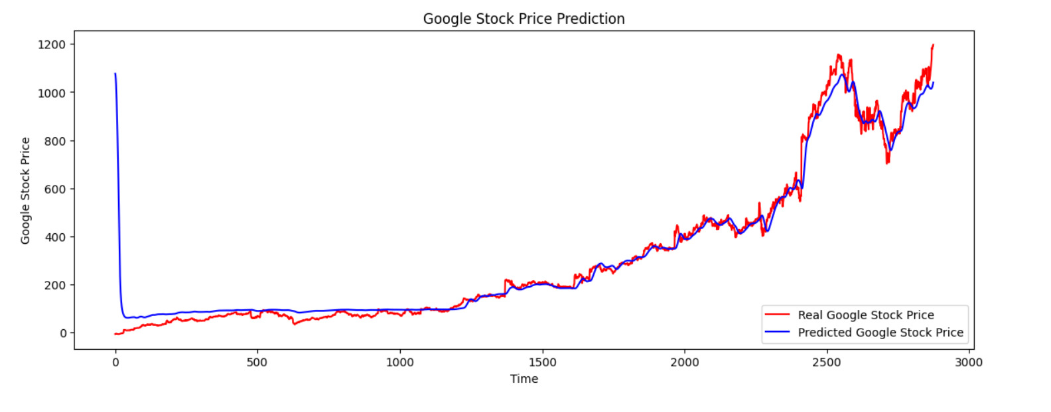
RESULTS
13

Slide 14
CONCLUSION
In conclusion, utilizing Recurrent Neural Networks (RNNs) for stock market value prediction presents promising results. Through the analysis of historical data, RNNs offer a dynamic approach to capture temporal dependencies and intricate patterns within the market. Despite inherent challenges such as volatility and unpredictability, RNN models demonstrate their efficacy in forecasting stock values with reasonable accuracy. Their ability to adapt and learn from sequential data makes them valuable tools for investors and financial analysts seeking insights into future market trends.
DEMO LINK: https://github.com/Kiruthigakd/TNSDC-Generative-AI-for-Engineering/blob/main/StockMarkerValuePredictionSyatem.ipynb

